Slide 1

Sailing Trip Planner (STP) by Beth Williams
About Me: The Back Story
Details: The Application. Why? How it Works, etc.
Demo:
Questions?

Slide 2
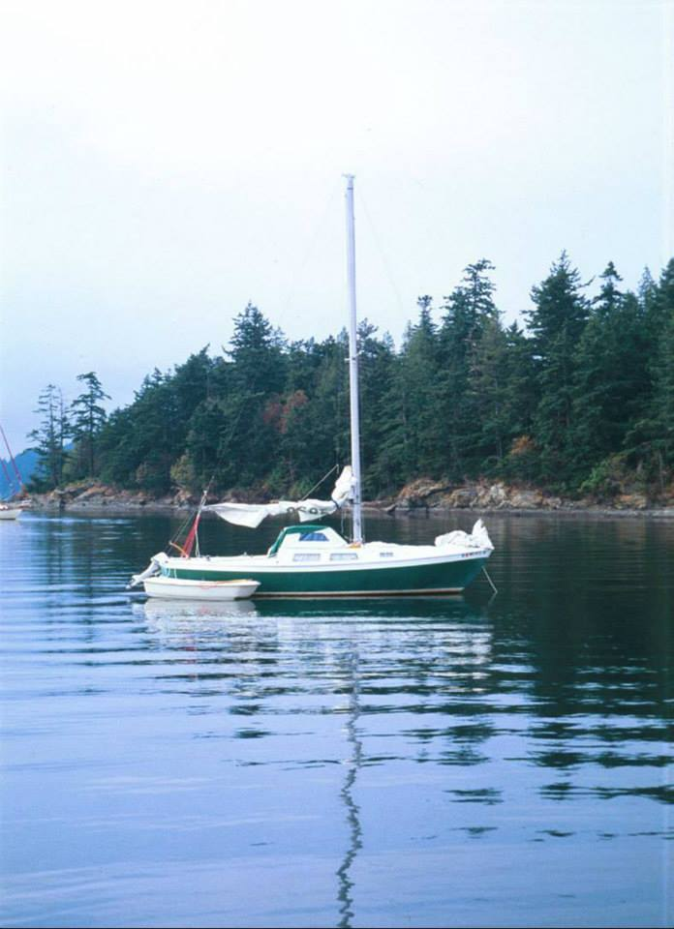
The Back Story
Live Aboard Sailor as an Undergraduate in College.
25 ft Sailboat, 1967 Cal 25.
Moored at Squalicum Harbor in Bellingham, WA.
Electricity
Water (hose or pump sink)
No shower/restroom on board
Marina Facilities (shower, bathroom, laundry, etc.)

Slide 3
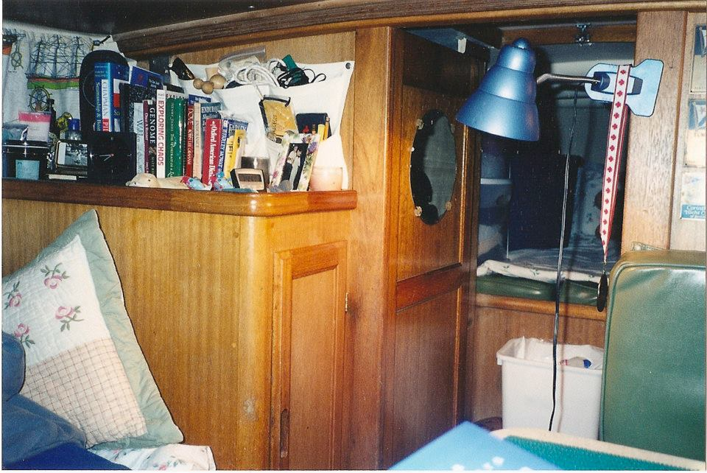
Cabin

Slide 4
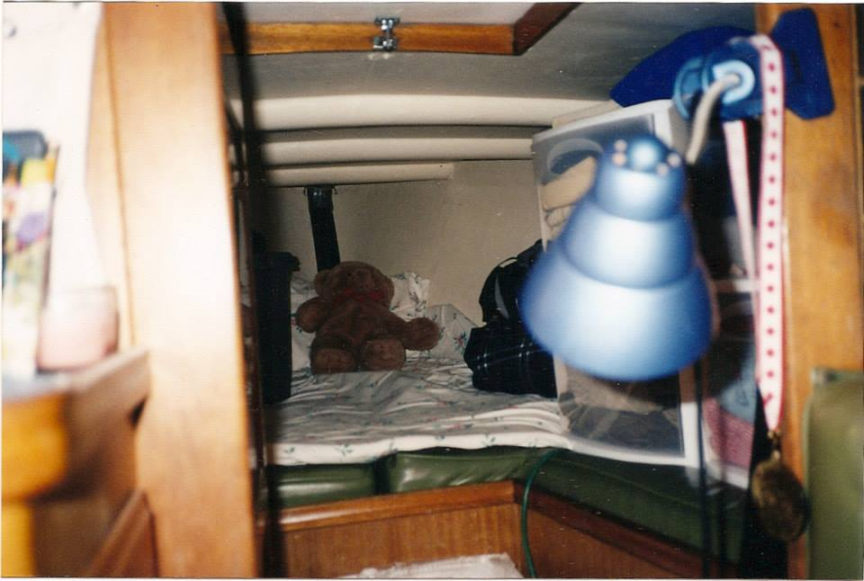
Sleeping Quarters

Slide 5

First Mate

Slide 6
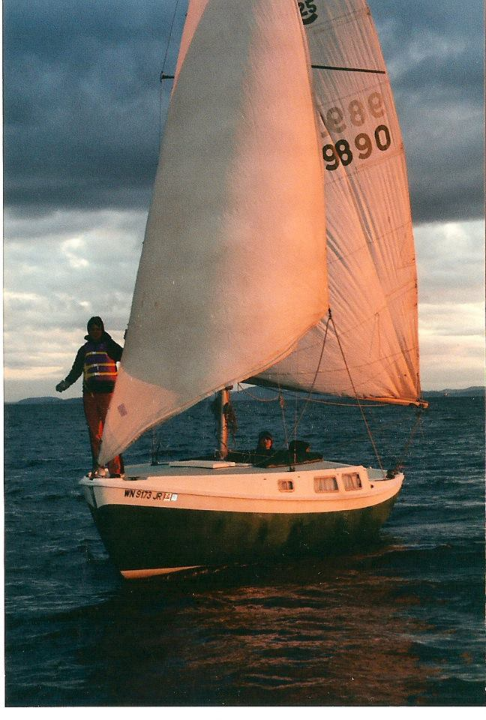
Me Sailing

Slide 7

Reunited: 2004 vs. 2016 (same Boat!!!)

Slide 8
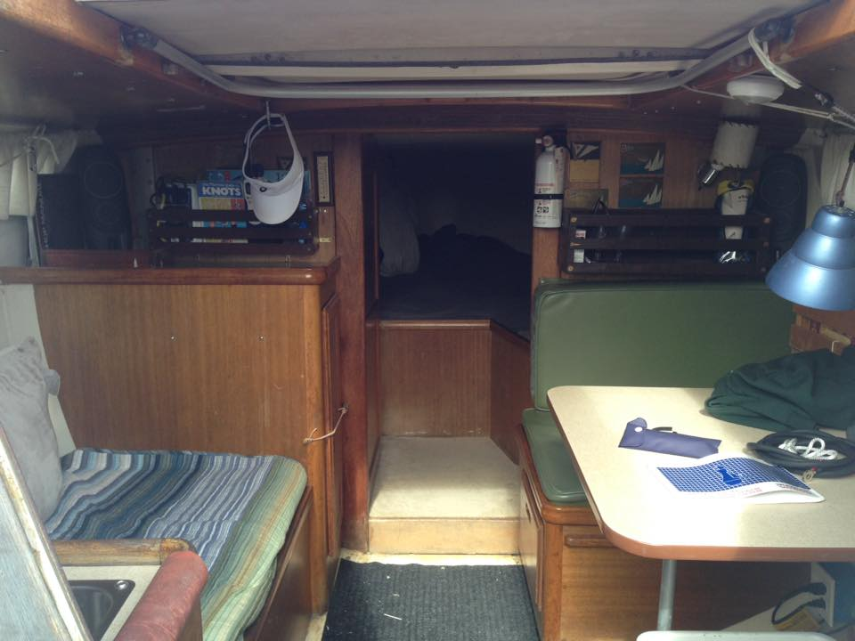
Cabin in 2016

Slide 9
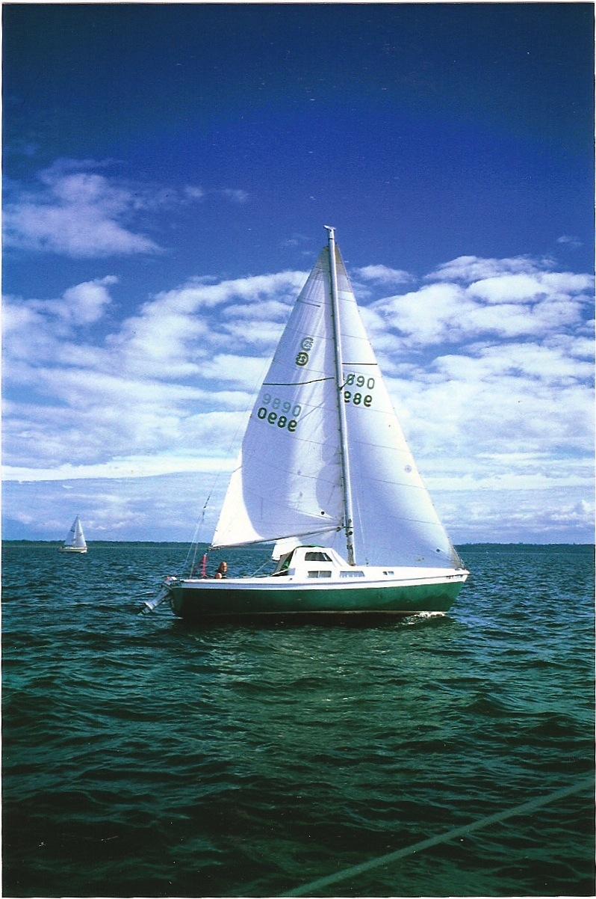
Sailing Trip Planner (C #/Windows Forms App)
STP: An “all-in-one” sailing trip planning tool, allowing users to access charts, navigation distances, weather, etc., and customize their personal Itinerary. Compatible for both “at sea” (no WiFi) and “at home” (with WiFi) use.

Slide 10


Bust Out Another Thousand
BOAT
OR
Bust Out Another Tool

Slide 11
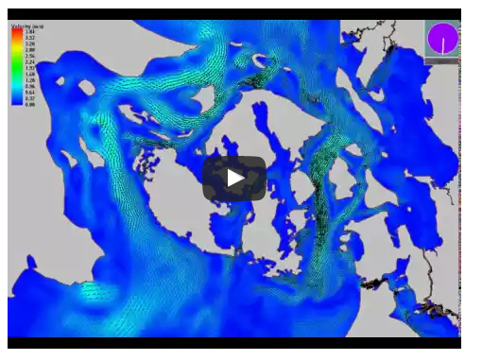
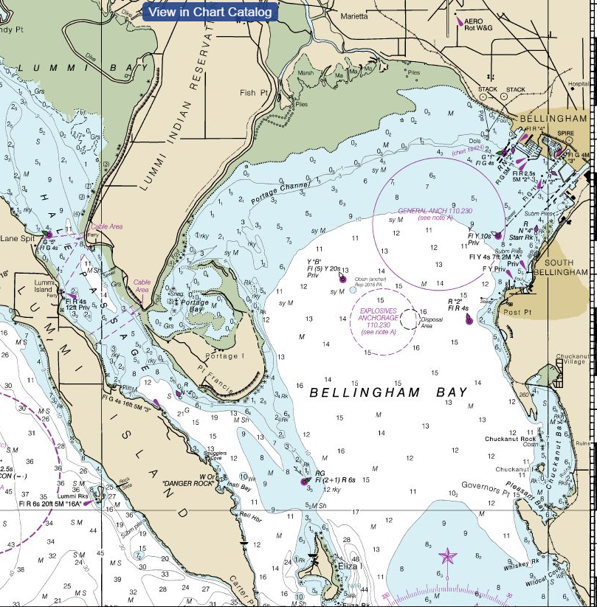
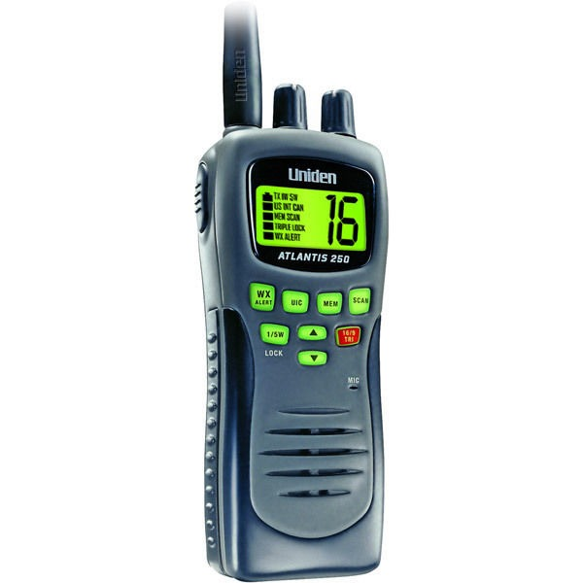
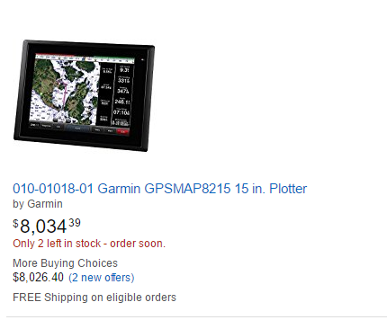
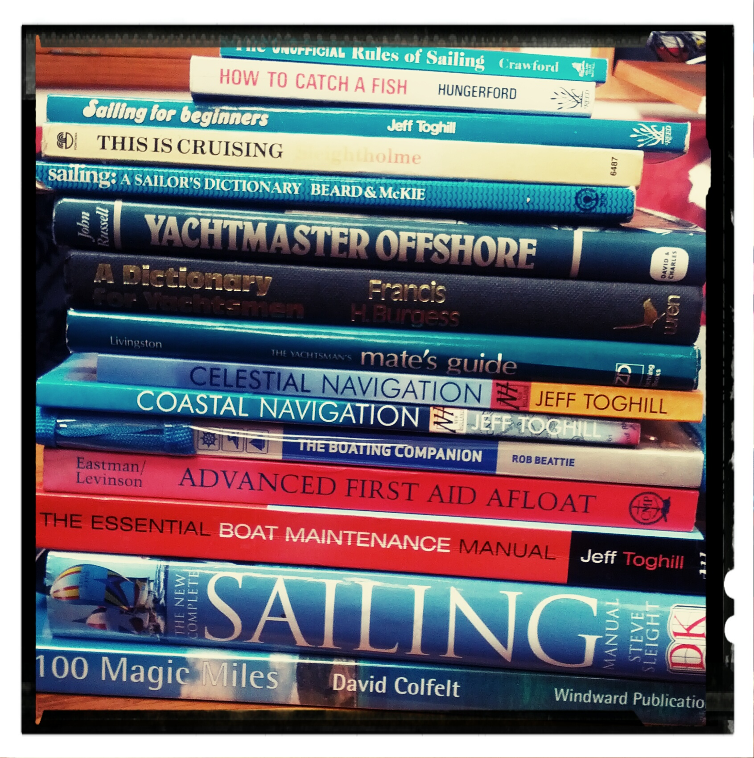
Sailing Tools
Charts
Currents https://youtu.be/8Ehp-hG3Mlc
VHF Radio
GPS Unit
Sailing Books

Slide 12
Windows Form Application: STP Widgets
Combo Boxes – Provide drop down menu selection
Text Fields – Accepts user input, as well as auto-populates
Date/Time Picker – Calendar menu
Buttons – Click event initiated by end user
Picture Boxes – Displays images
Web Browser – Displays indicated web url.
Radio Buttons – To be selected by users.

Slide 13
The Code: C #
Data Sets – Stores imported Excel Data.
Events – Majority of Widgets have a corresponding event handler.
Try-Catch – Handles invalid entries by user.
Message Boxes – Prompts user with messages, both error prompts and successful execution of program.
Switch-Case – Determines what action to take based on user selection.
Lists/Dictionaries
SQL Query – Selecting section of data.

Slide 14
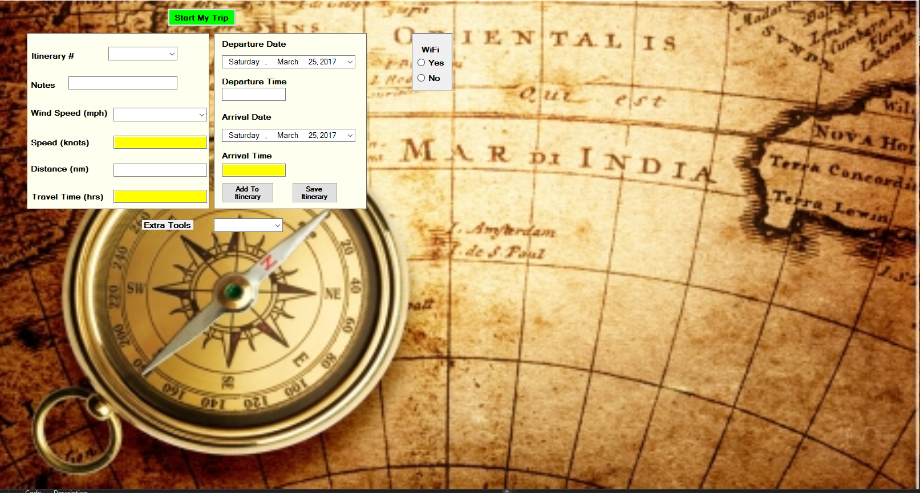
STP: Navigation, Weather, Distances, Itinerary…

Slide 15
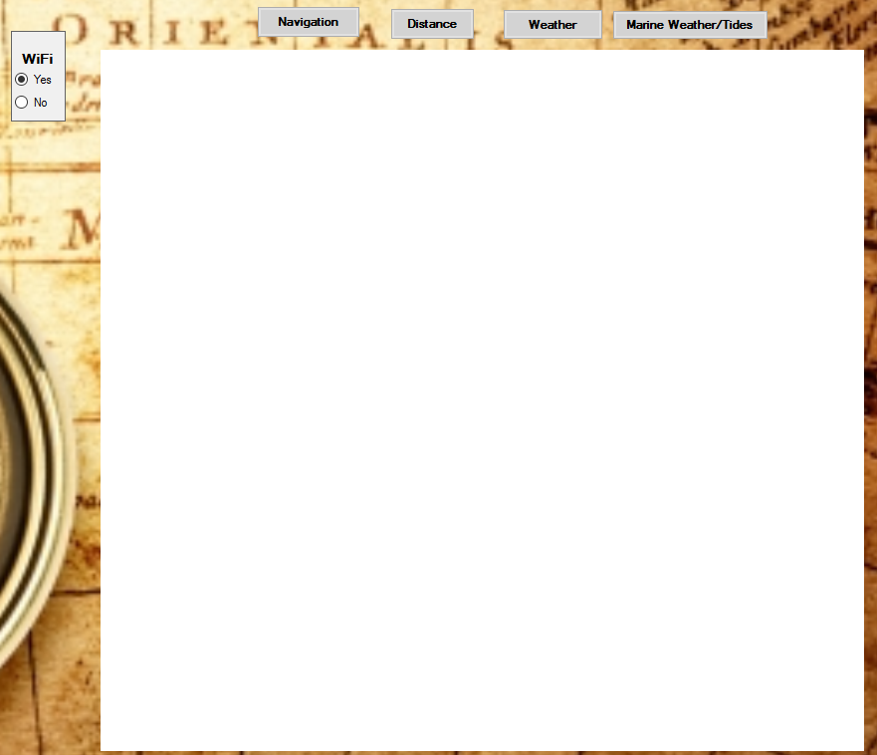
WiFi Options: web based navigation, distance, weather/marine weather
With WiFi

Slide 16
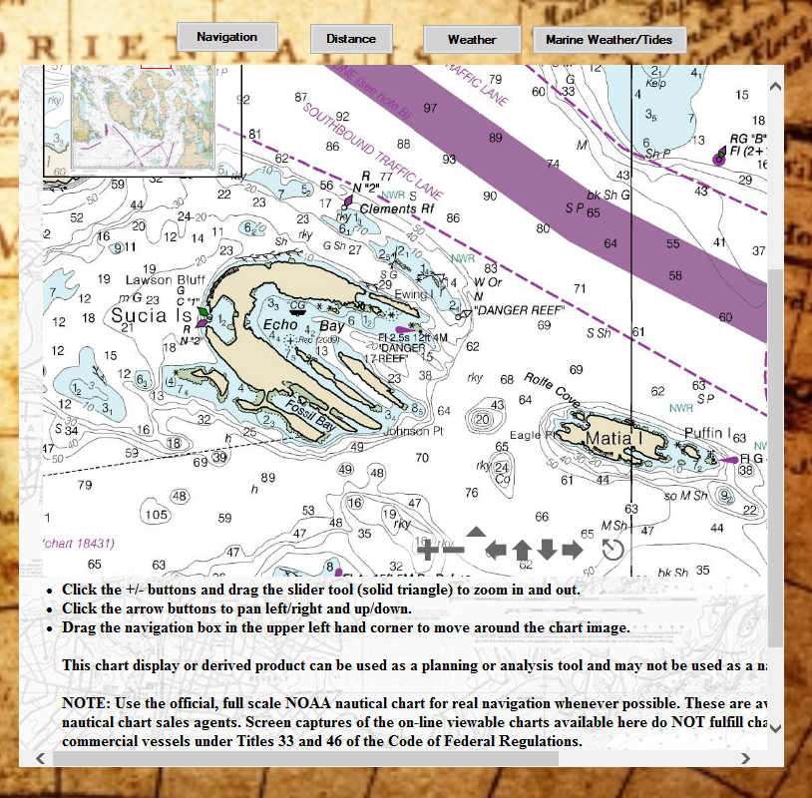
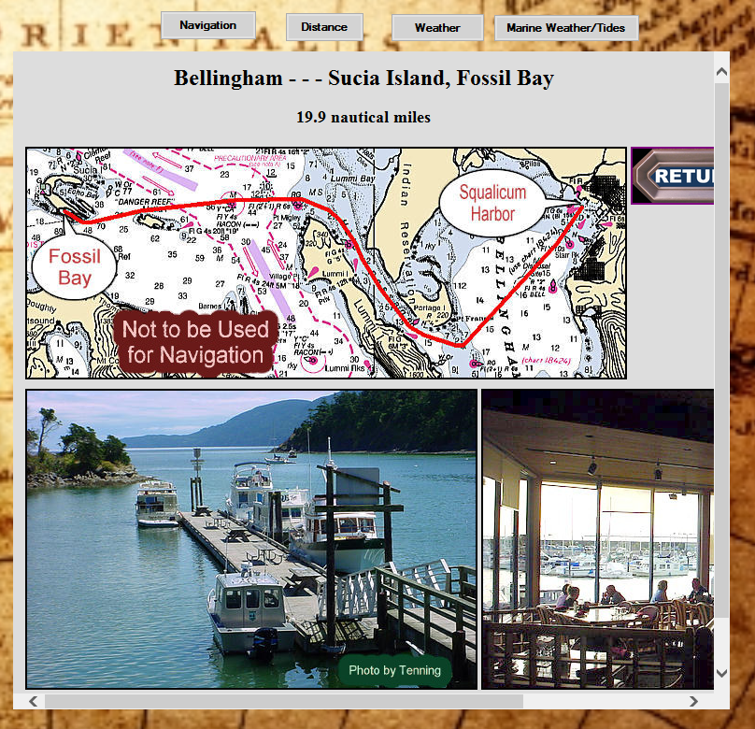
Navigation & Distance

Slide 17
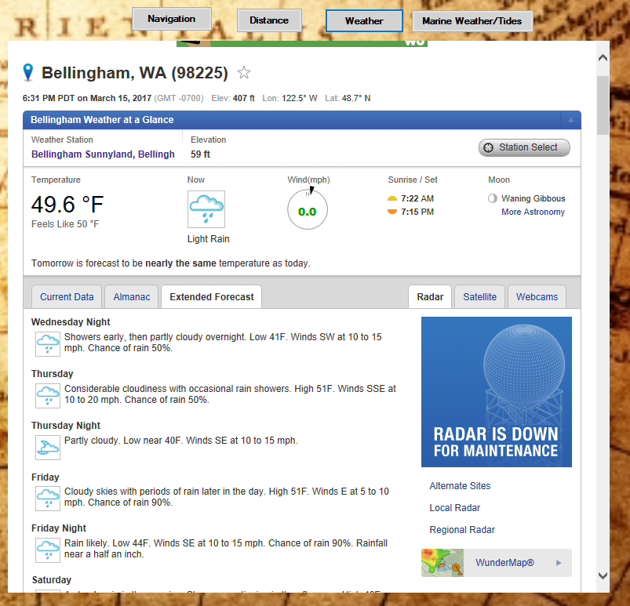
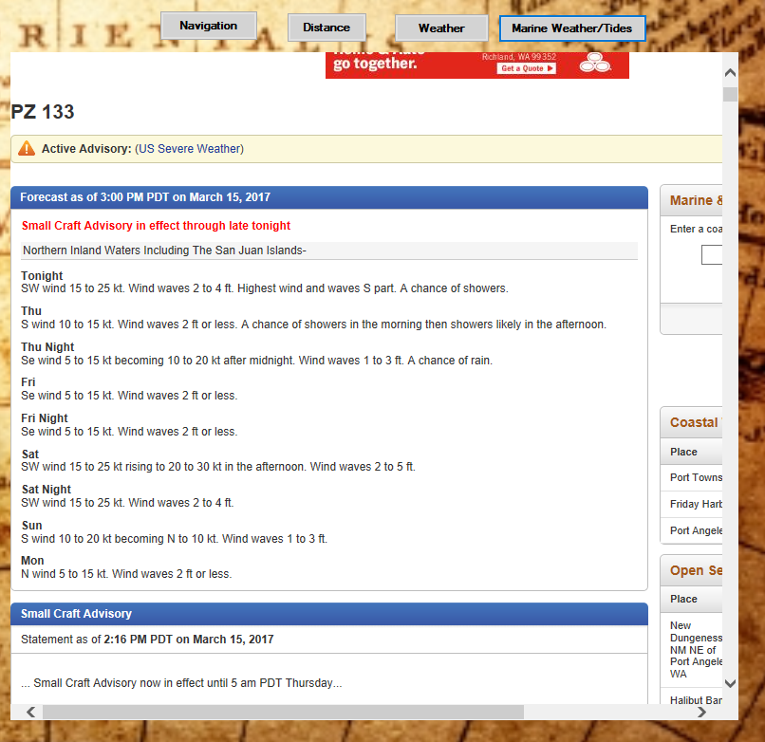
Weather & Marine Weather

Slide 18
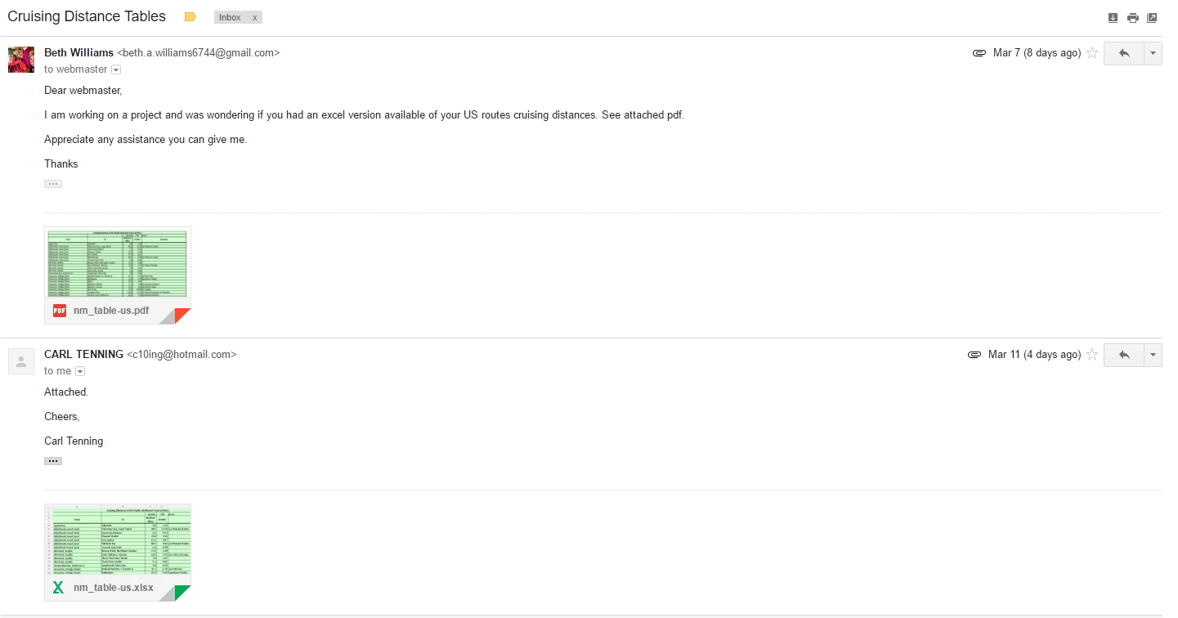
Getting Data for no WiFi : Be Resourceful

Slide 19
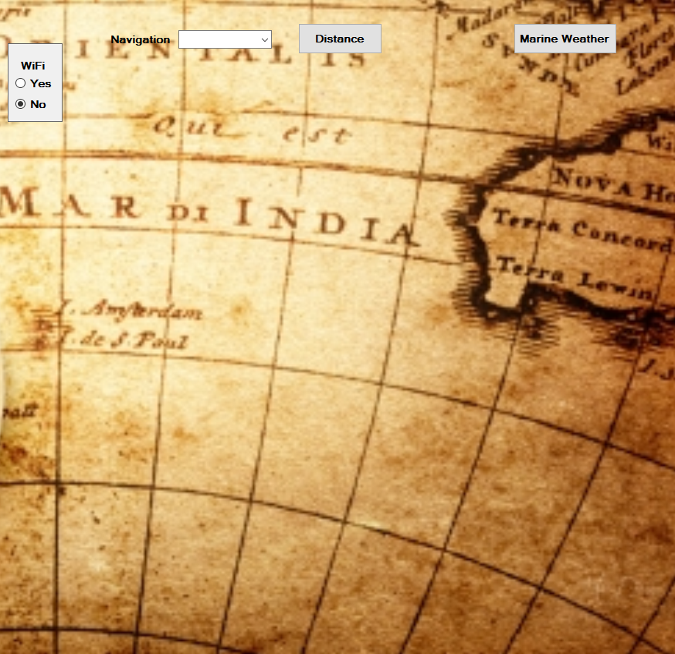
No WiFi:
Without WiFi

Slide 20

Importing Data from Excel
Import Excel (.xls or .xlsx) into C# using “Provider=Microsoft.Jet.OLEDB.4.0”.
Install http://www.microsoft.com/download/en/confirmation.aspx?id=23734
Add using directive “using System.Data” & “using System.Data.OleDb”.
Format Excel cells from “General” to Text” format.
Add reference by right clicking Project, COM\Libraries\Microsoft Office 16.0 Objet Library.

Slide 21
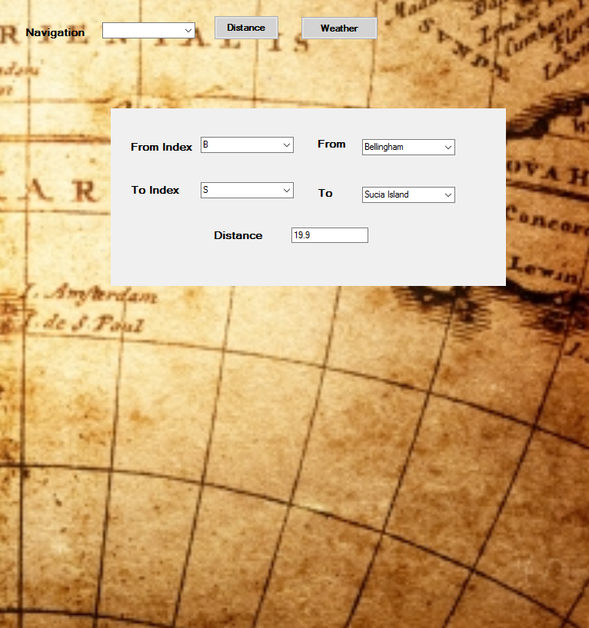
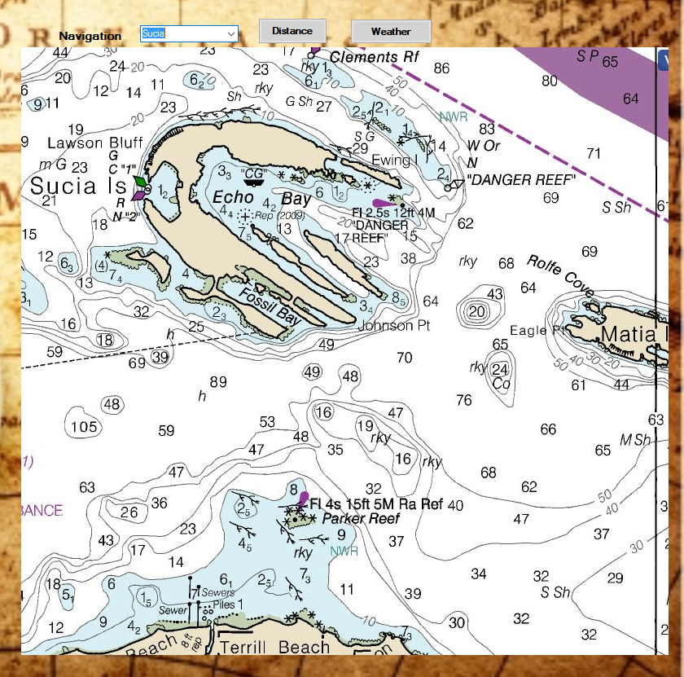
No WiFi: Distance (Excel) & Navigation (PNG)

Slide 22
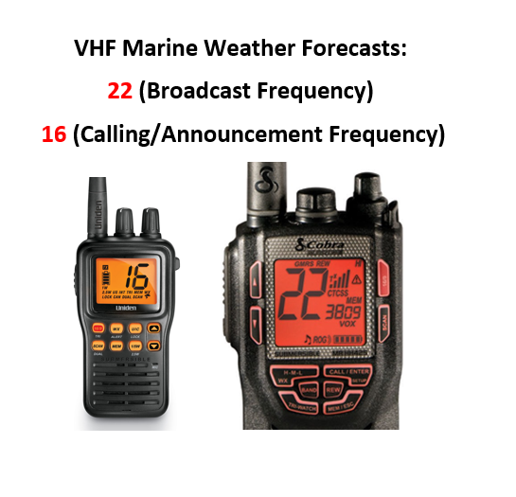
Weather with no WiFi

Slide 23
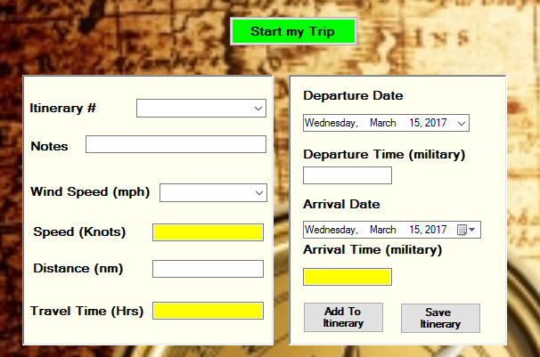
Itinerary
1.
2.
2.
4.
3.

Slide 24
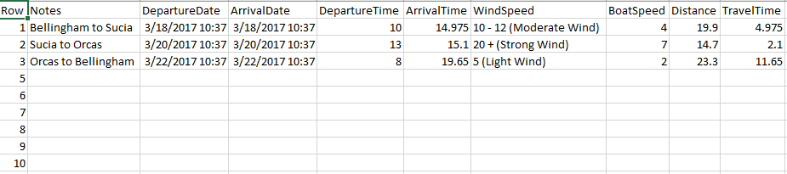
Saved Itinerary: Exports to Excel
Visual Studio (Exporting to Excel)
Add Reference: Microsoft Excel 16.0 Object Library.
Add using Directive: “using Excel = Microsoft.Office.Interop.Excel”;

Slide 25
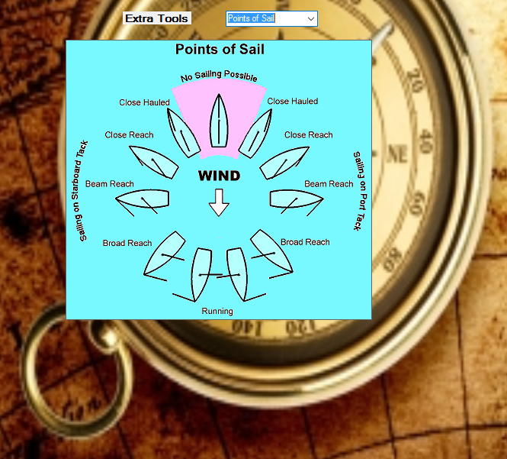
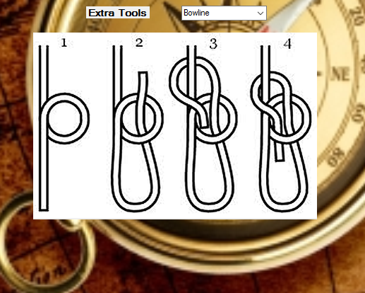
Extra Tools: Easy Access Reference Material

Slide 26
Application DEMO
C:\Code Projects\Sailing\bin\Release

Slide 27

The End

Slide 28
Questions ?

